Slide 1
Data Analyze for the Int Monthly Visitor

Slide 2
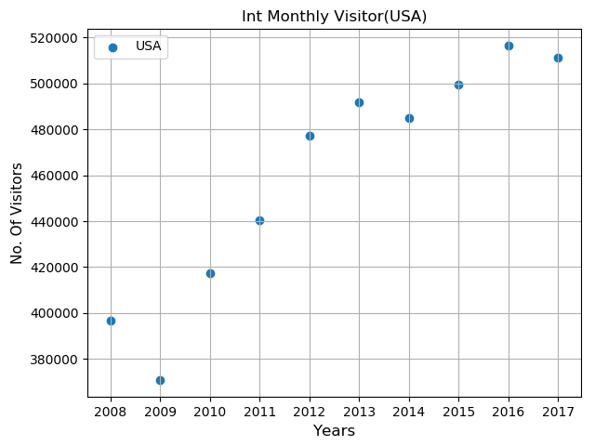
Int Monthly Visitor (USA)

Slide 3
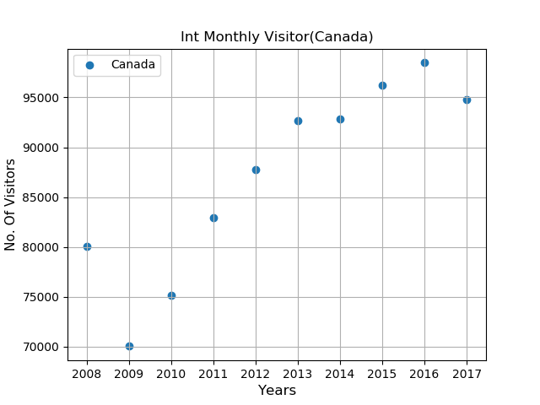
Int Monthly Visitor (Canada)

Slide 4
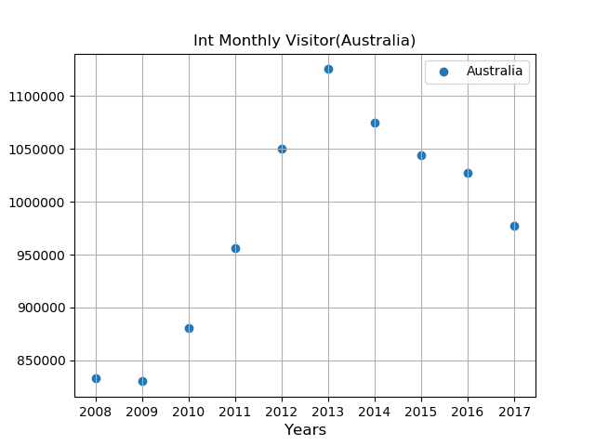
Int Monthly Visitor (Australia)

Slide 5
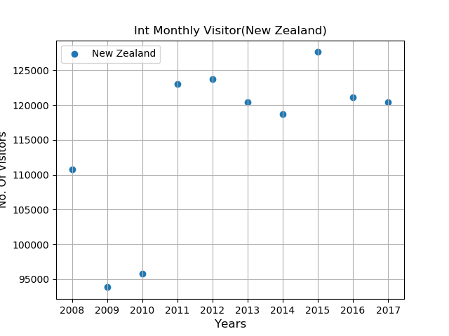
Int Monthly Visitor (New Zealand)

Slide 6
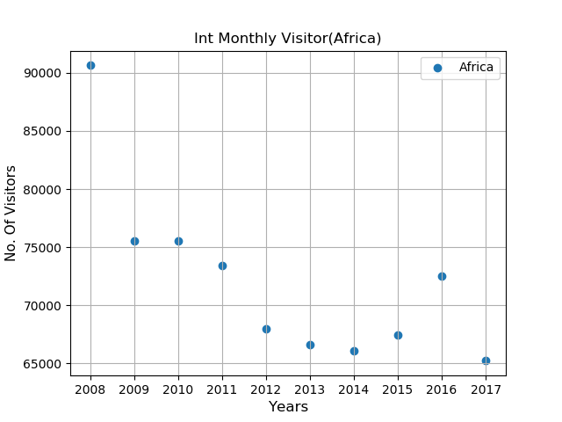
Int Monthly Visitor (Africa)

Slide 7
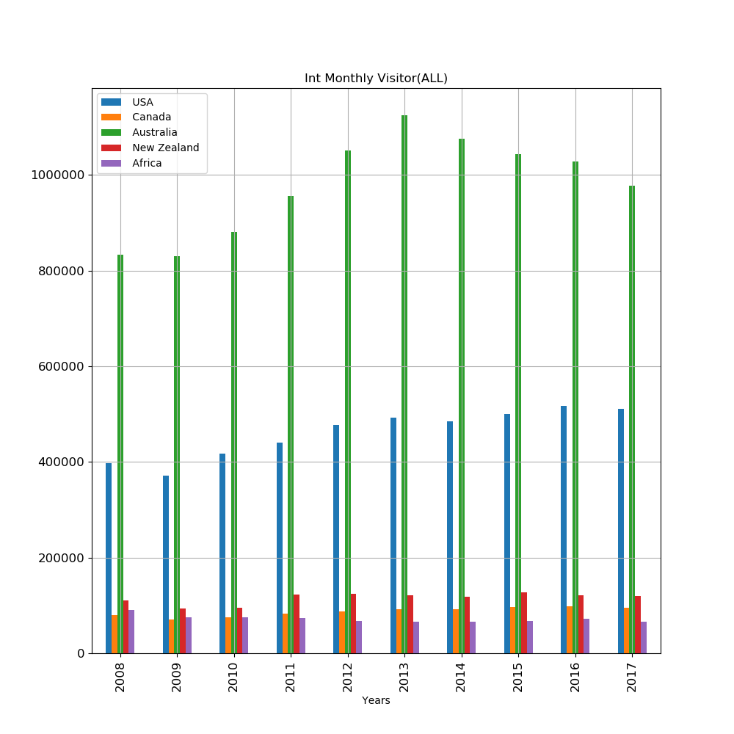
Total Int Monthly Visitor(All Countrys)

Slide 8
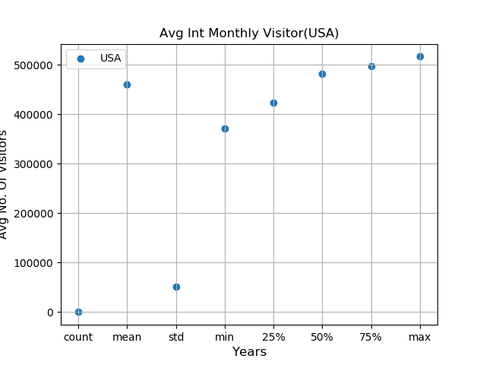
Avg Int Monthly Visitor (USA)

Slide 9
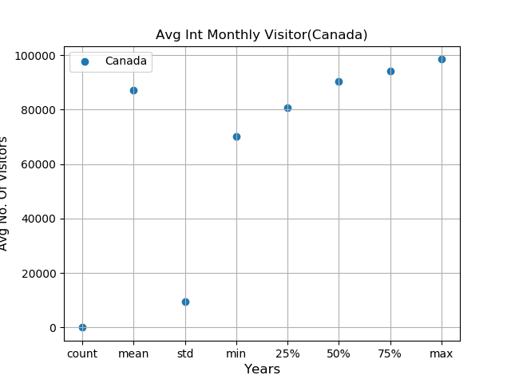
Avg Int Monthly Visitor (Canada)

Slide 10
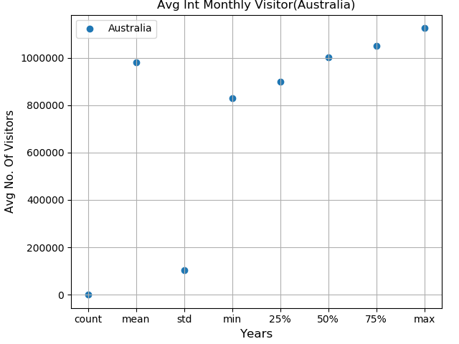
Avg Int Monthly Visitor (Australia)

Slide 11
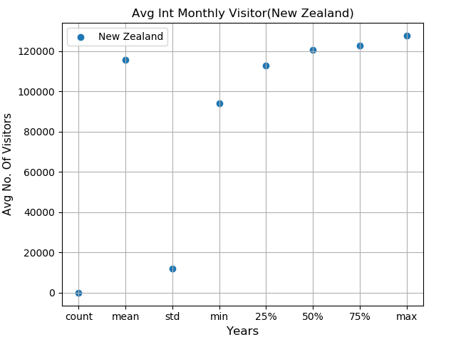
Avg Int Monthly Visitor (New Zealand)

Slide 12
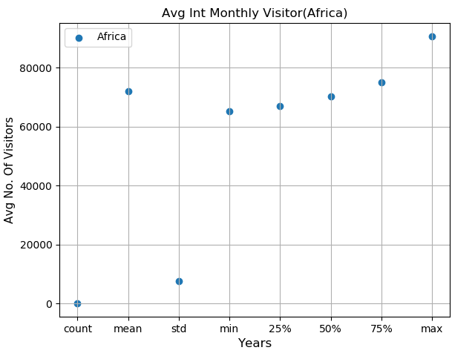
Avg Int Monthly Visitor(Africa)

Slide 13
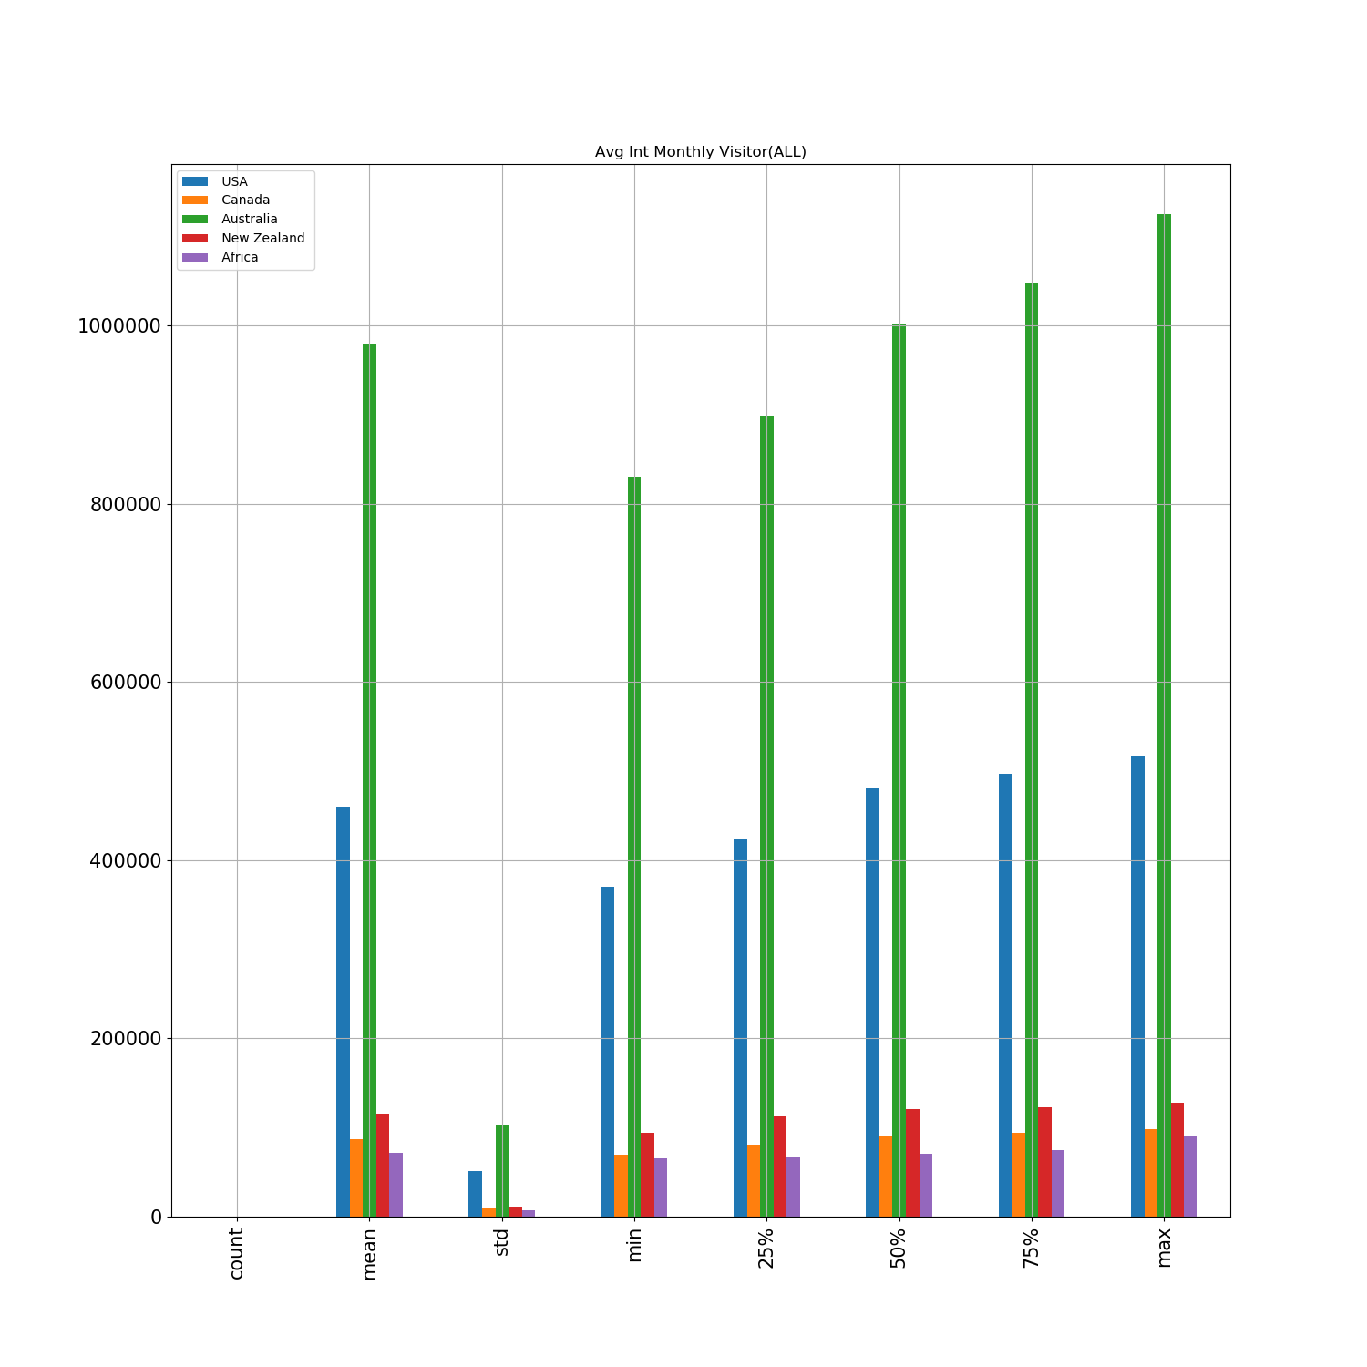
Total Avg Int Monthly Visitor(All Countrys)

